Slide 1
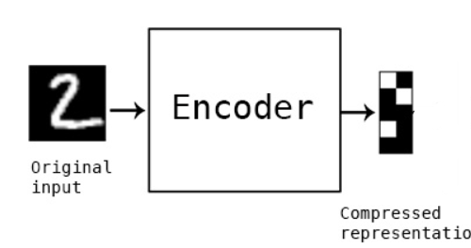
Why is it Important?
Data Compression: The encoding is much smaller than the original data, making it efficient to store and transmit.
Feature Extraction: The encoder learns to extract valuable information, which can be used for various tasks.

Slide 2
What is a Decoder?
The decoder is like an artist that takes the compact representation (encoding) from the encoder and recreates the original data.
It's the second part of the autoencoder and responsible for generating output from the encoding.

Slide 3
How Does the Decoder Work?
Imagine a decoder as a reverse funnel that expands the compact representation back into a full image or data.
It transforms the encoding from the latent space back into a reconstructed output.

Slide 4
Decoding Process
Step 1: The encoded data (latent space representation) is fed into the decoder.
Step 2: The decoder consists of layers that learn to reverse the compression process by generating features and patterns.
Step 3: These generated features are combined to reconstruct the original data.

Slide 5
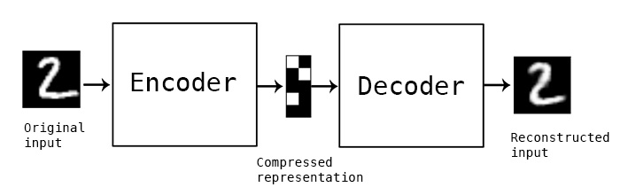
Recreating Original Data
The decoder's goal is to recreate data as close to the original input as possible.
It uses the knowledge it gained from the encoder to generate meaningful features.

Slide 6
Why is it Important?
Data Reconstruction: The decoder's job is to bring back the data's original form from the compressed encoding.
Completing the Loop: Autoencoders aim to minimize the difference between the input and the reconstructed output.

Slide 7
Simple/Vanilla Auto-encoder

Slide 8
Types of Auto-Encoders
Vanilla Autoencoder
Denoising Autoencoder
Variational Autoencoder (VAE):

Slide 9
Denoising Autoencoder

Slide 10
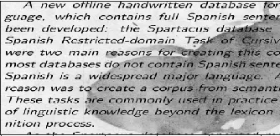
Input Image

Slide 11
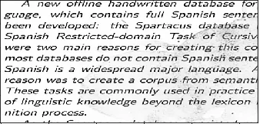
Output Image

Slide 12
Denoising Autoencoder
Denoising Autoencoders are a type of neural network.
Designed to clean noisy or corrupted data and extract essential features.

Slide 13
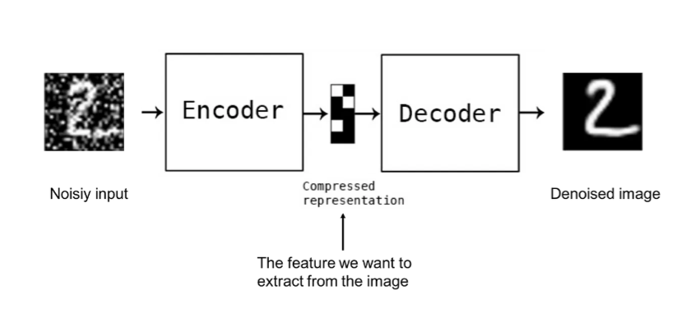
Denoising Autoencoder

Slide 14
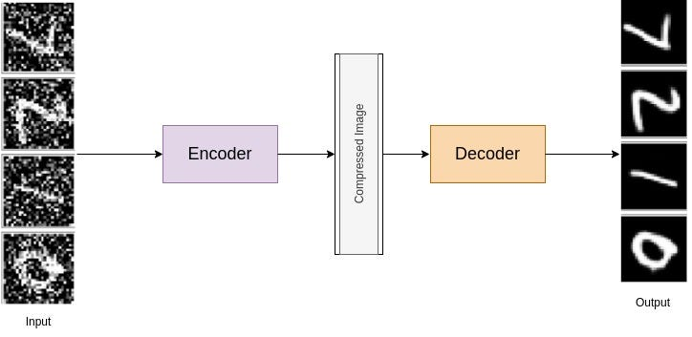
Denoising Autoencoder

Slide 15
Quiz

